Slide 1
Building Insights from Trips Data at Big Data Scale
Devon Simpson, Trang Nguyen
CUGOS Spring Fling
April 21, 2023

Slide 2
Topics INRIX Intro Trips Overview Use Cases and Insights derived from Trips Data Big Data Geospatial Processing - Spark and JTS - Apache Sedona Q&A
2
Notes:
Trip Paths is a new product specifically developed by INRIX to help our clients answer road travel questions more quickly and accurately than has previously ever been possible

Slide 3

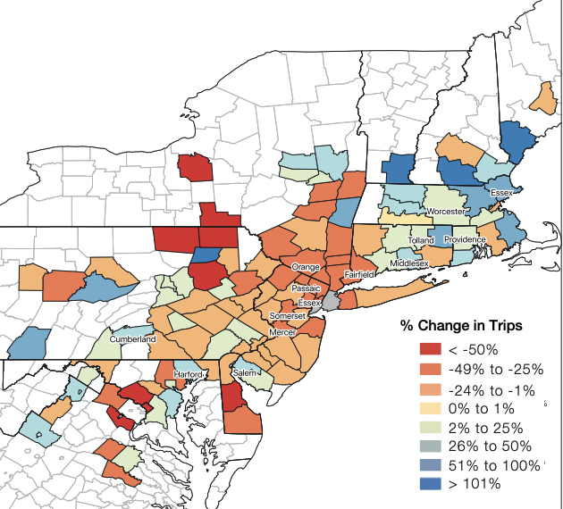
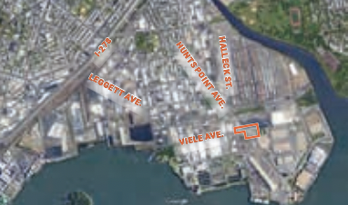
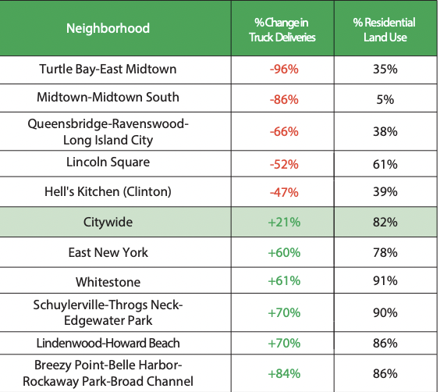
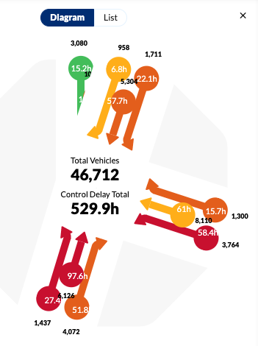


INRIX Trip Analytics Use Case Examples
Real world use cases
Myriad of Use Cases
Anonymized location-based data
Faster and smarter to improve decision-making and measure the impact of change.
Open Streets
Determine re-routes (diverted trips) resulting from street closures
Origin-Destination Analysis
COVID impact on Truck Trip Origins by County in NYC
Safety Planning
Effective planning for Vision Zero safety efforts
Construction Mitigation Effectiveness
Before/After trip patterns including alternate parallel routes
OSM
Places
Census
Crashes
Trips
Trajectories
Freight Studies
Truck Deliveries by neighborhood
Signal Analytics
Key performance metrics at intersections and for each turn maneuver
Travel Demand Modeling
14th Street Busway Project.
EV Infrastructure Planning
Number of cars moving through corridors to plan for efficient curb usage
Notes:
Massachusetts transitioned from traditional toll plazas to electronic open road tolls on Interstate 90 (Mass Pike) in 2016
What percentage of trips started and/or ended within a quarter-mile (or any distance of interest)
from an available transit stop? What was the travel time for these trips (for comparison to the
possible transit trip)?”

Slide 4
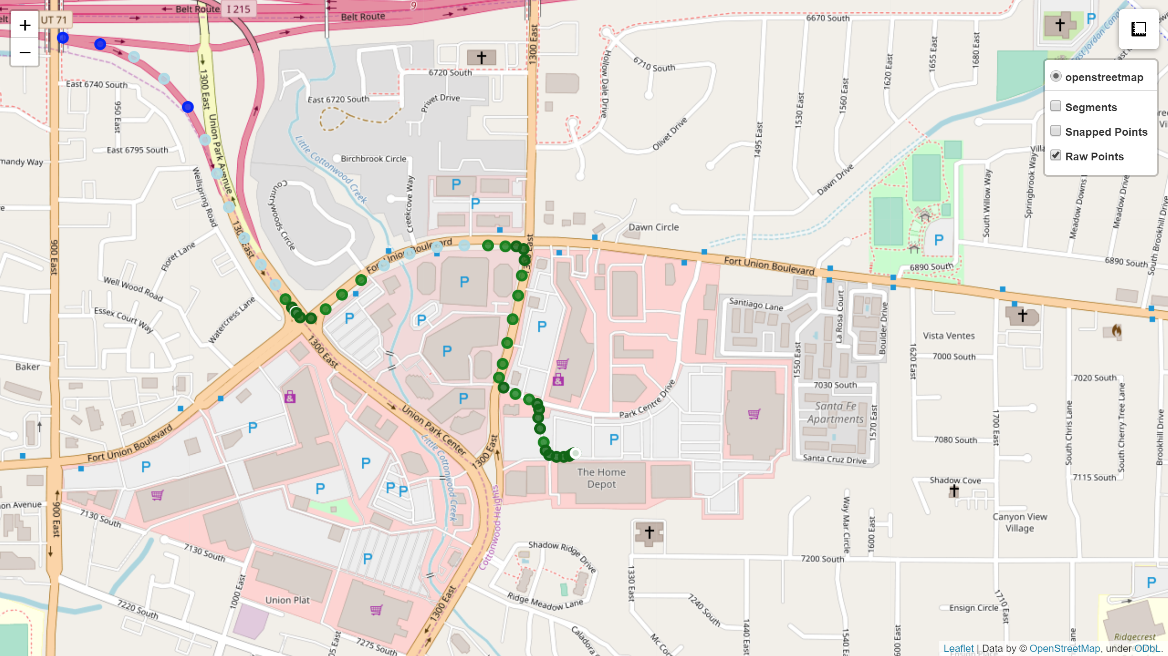
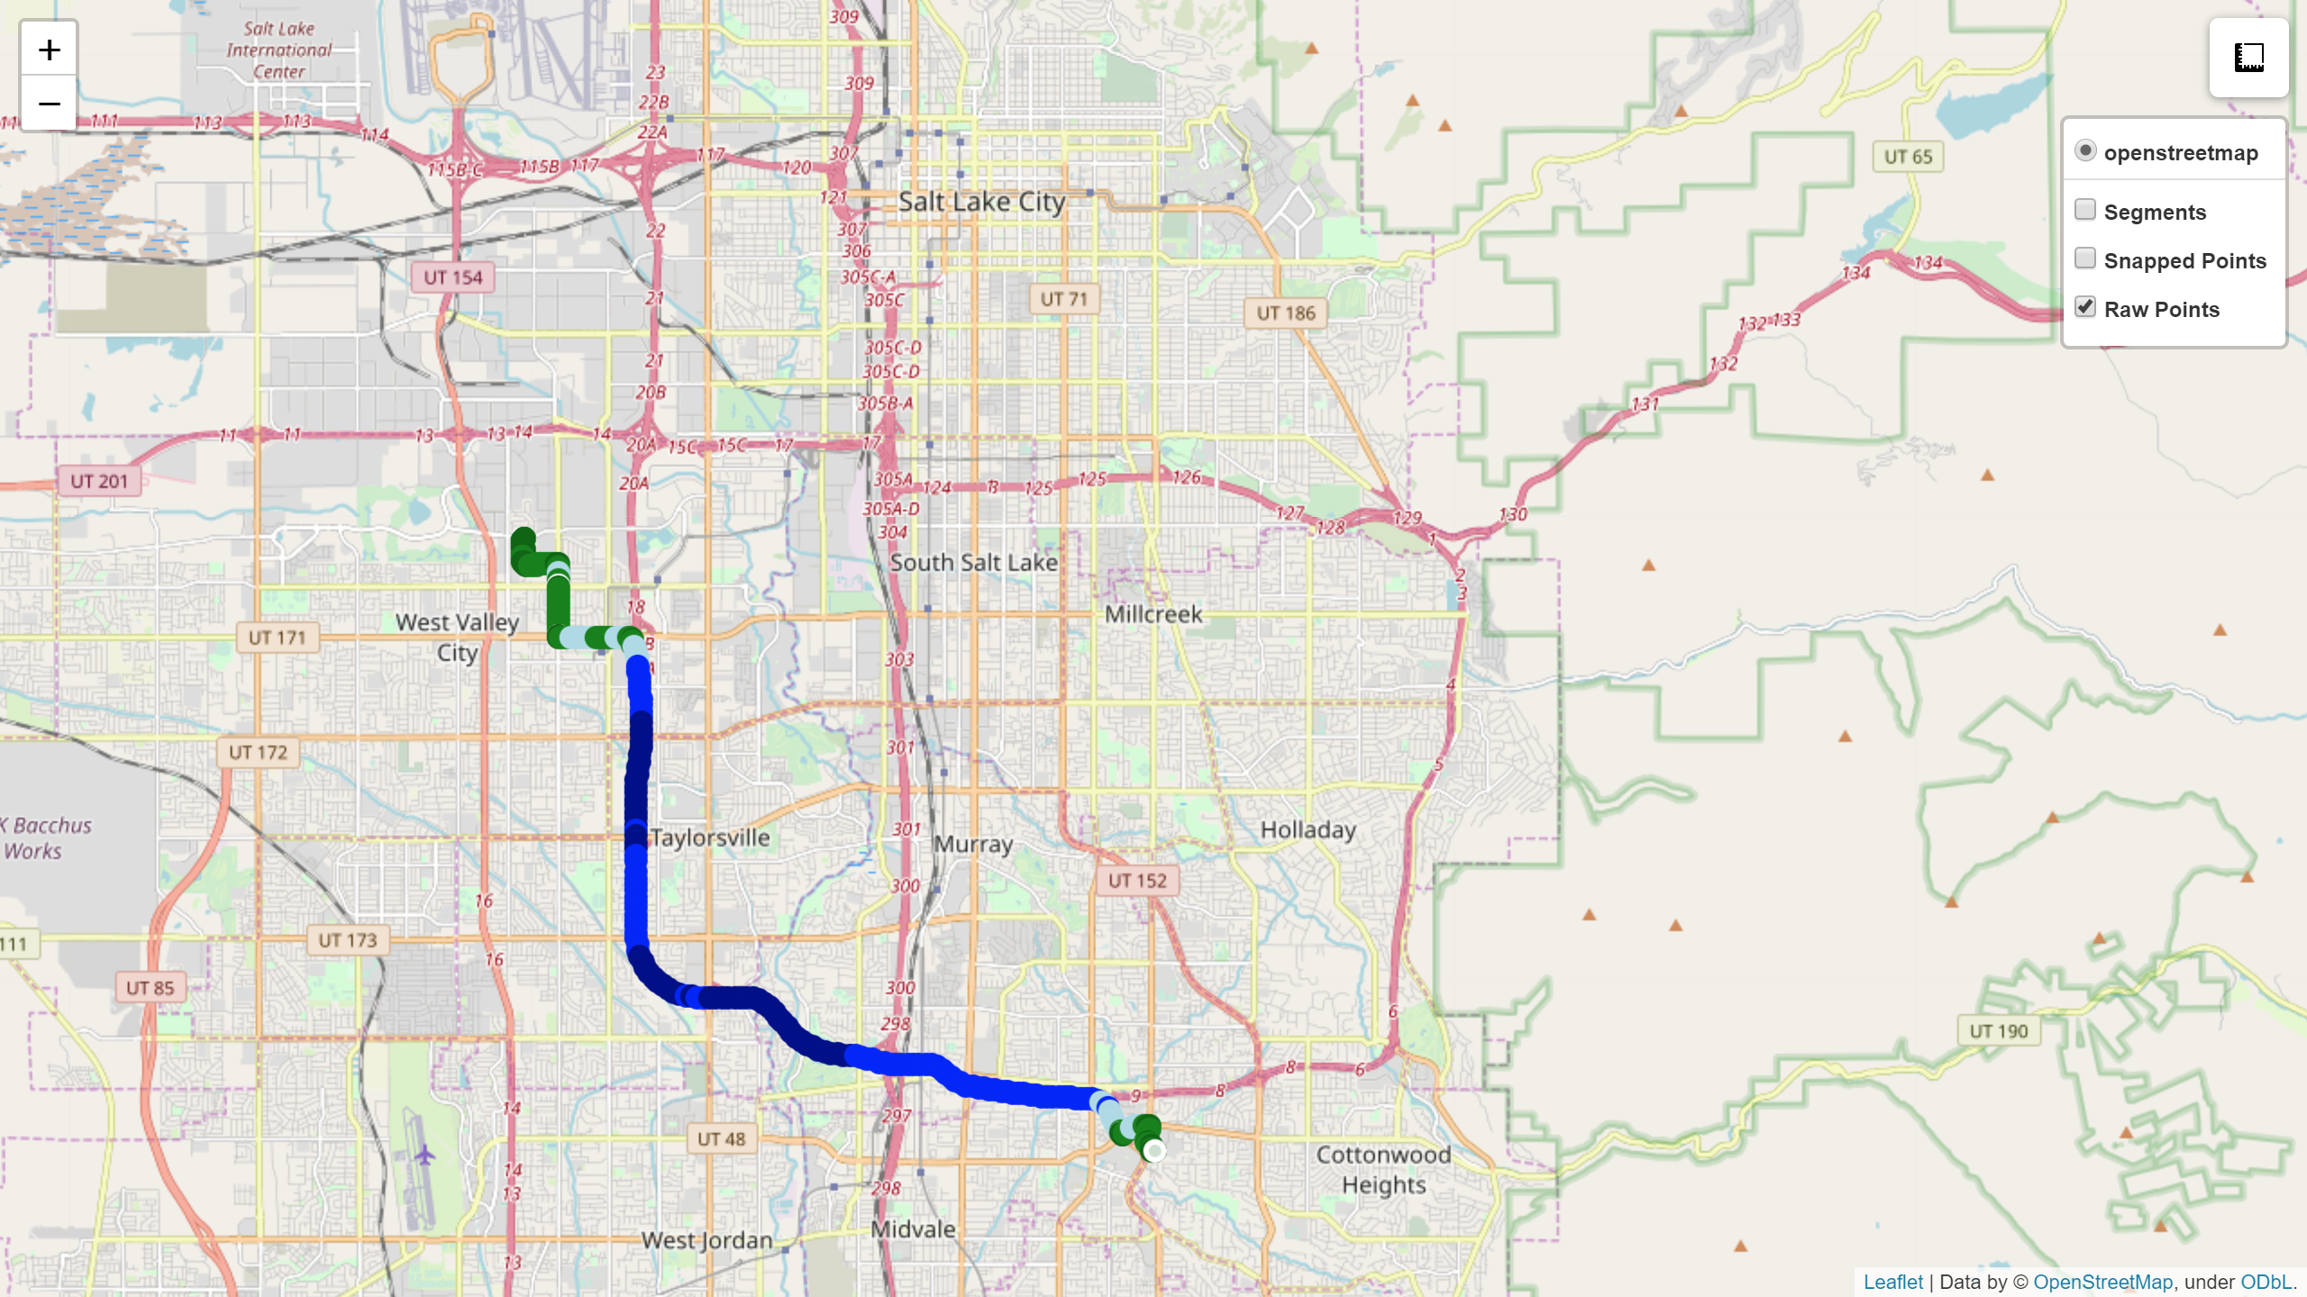
Building Block for Big Data Solutions – The Trip
Trips provide insight into the journeys people take, where they start from, where they end and the routes they take.
Modern methods for data collection using connected car, fleet and mobile data
Data is spatial and temporal
Formed by connecting GPS coordinates for a given user or vehicle in travel order
Inferred mode of travel and for a defined purpose: vehicle, pedestrian, bike (school drop off, store visit, etc)

Slide 5
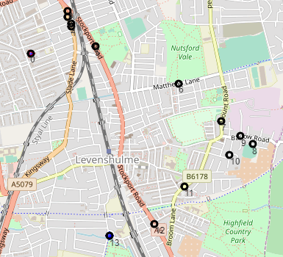
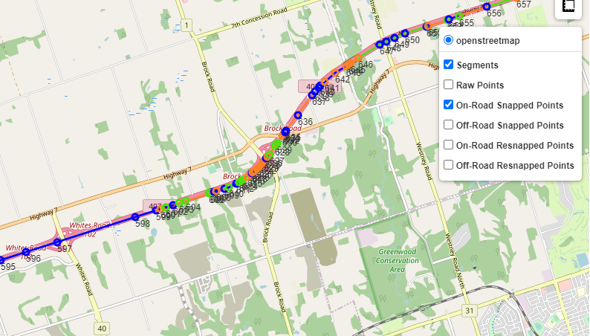
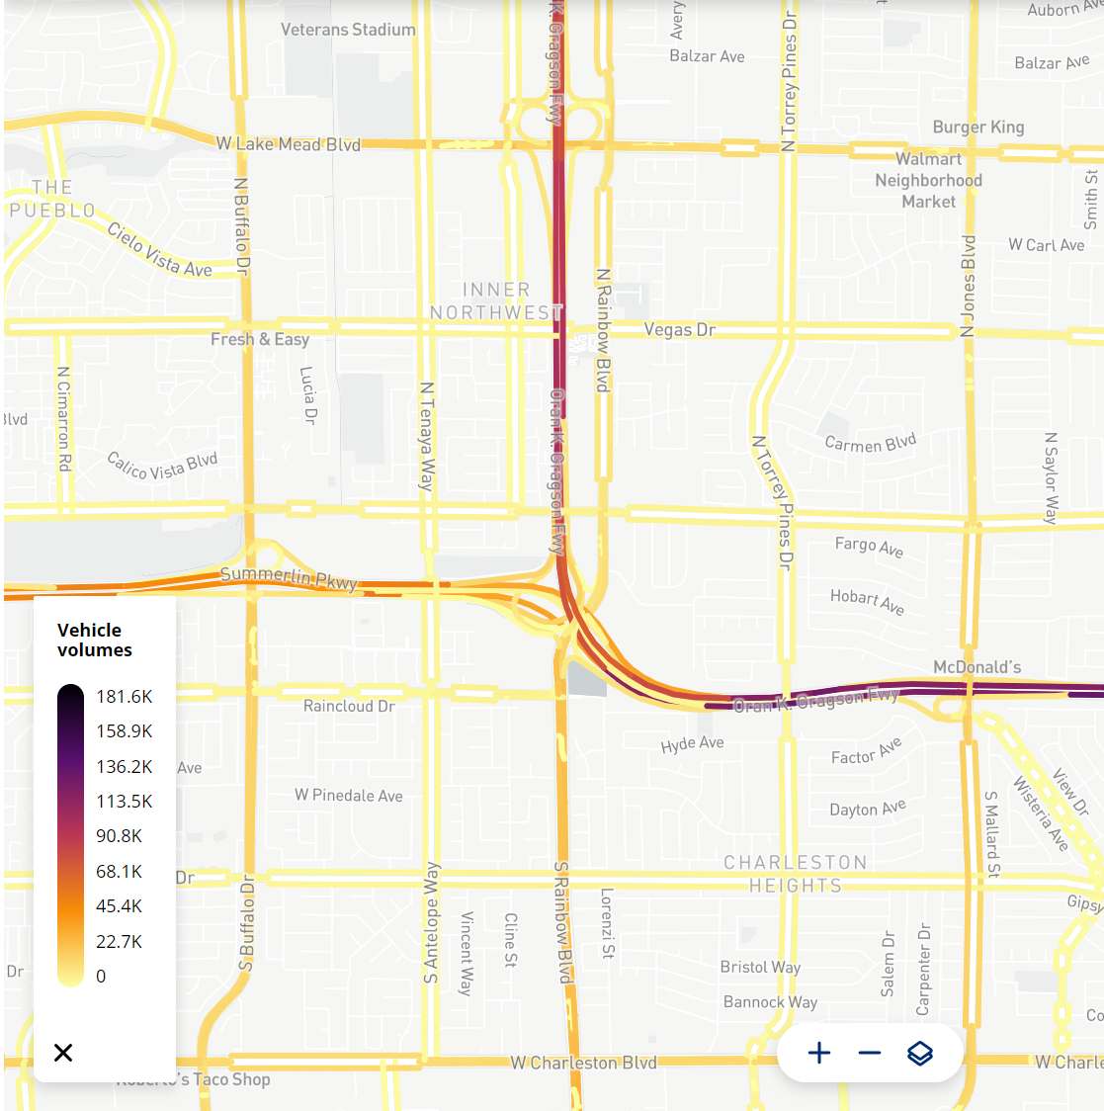
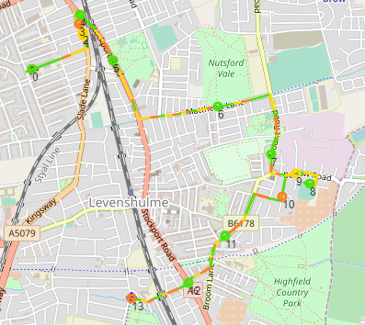
From Trips to Insights
GPS Points
Trips
Map Matched OSM Trajectories
Segment and Corridor Based Insights
Visits

Slide 6
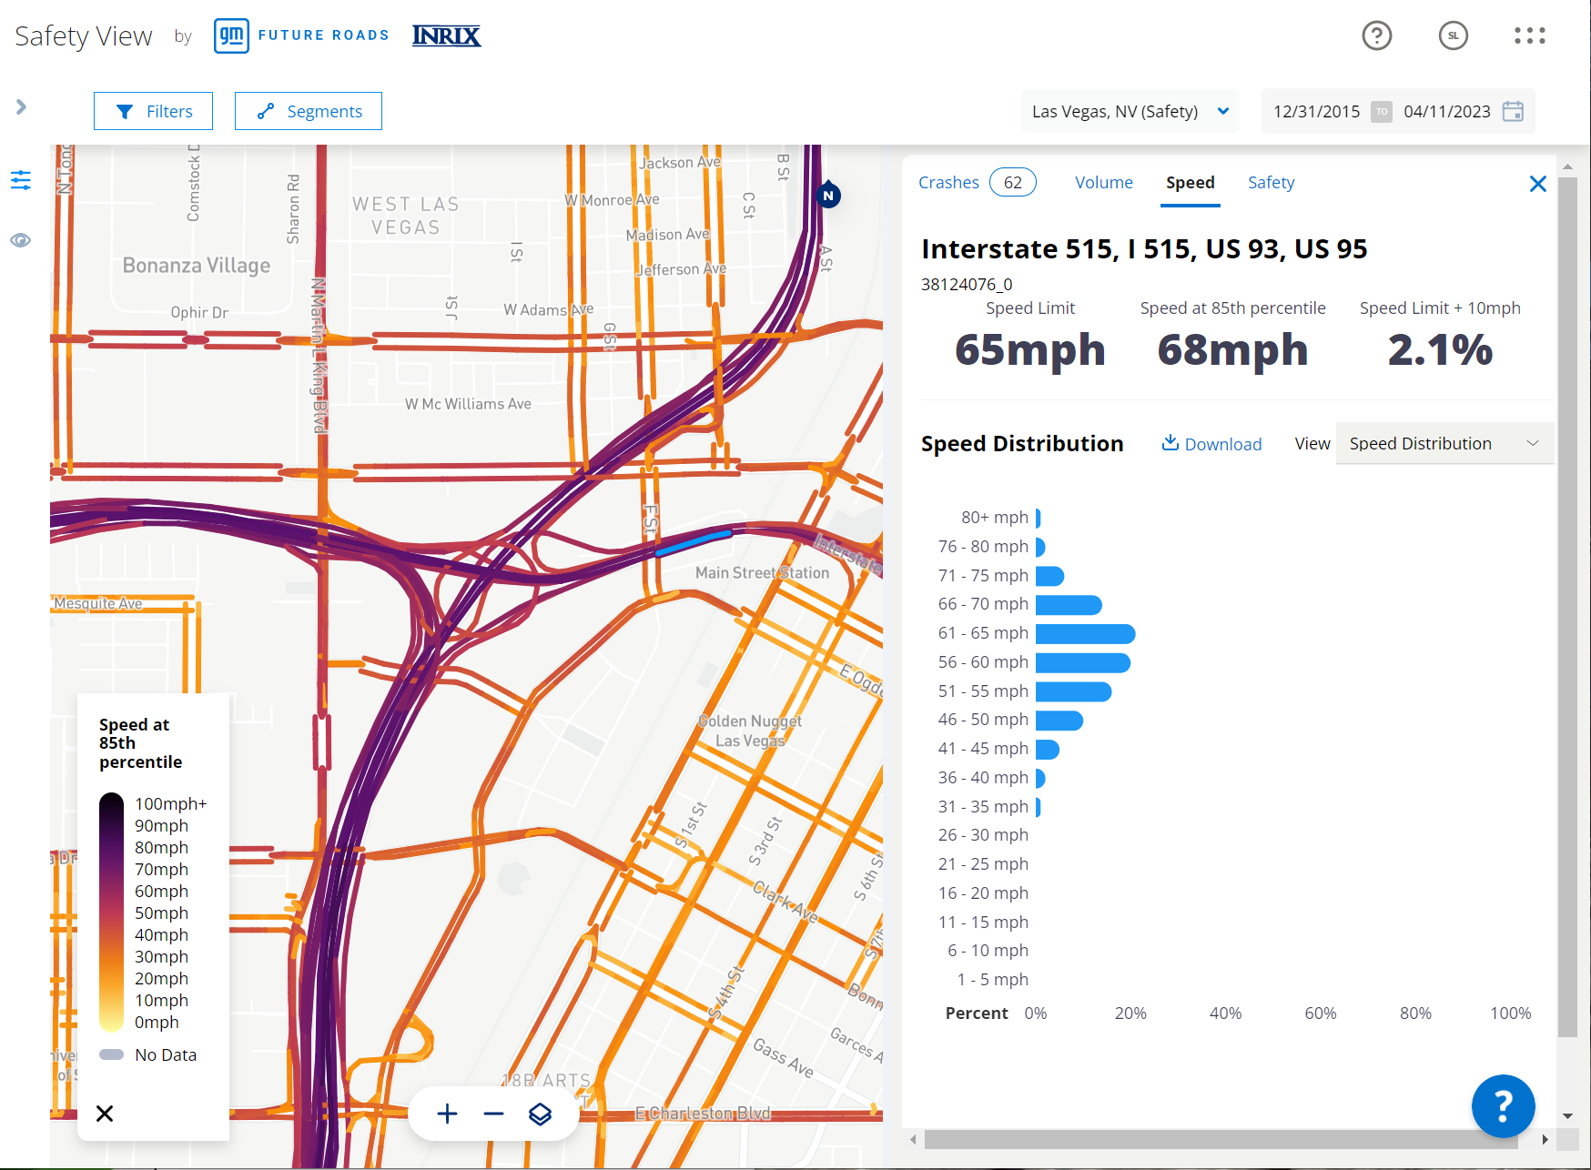
Segment (Way) based analytics
Stack months of Trip data for coverage and confidence
Trip based datasets:
Estimated volume on roads
Speed distribution
Percentage of vehicles speeding
Signal performance metrics
Vulnerable Road User relative usage
External datasets
Snapped city crash feeds
Company partners

Slide 7
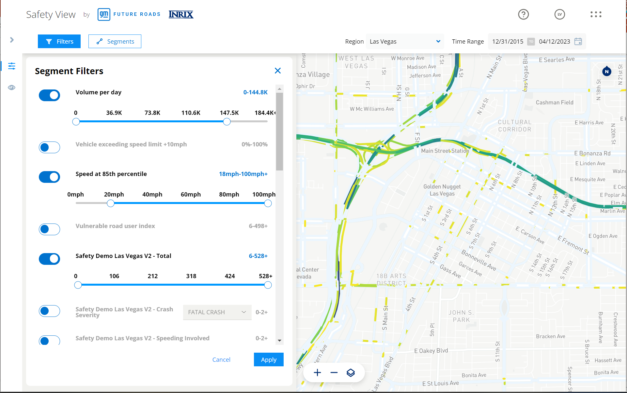
Segment Analytics for Safety
Common Segmentation allow for comparisons
Vision Zero funding enabled by 2021 Infrastructure Bill
Common segmentation
Data analytics with comparison, filtering, and ranking
Allows insights to roadways with risk factors

Slide 8
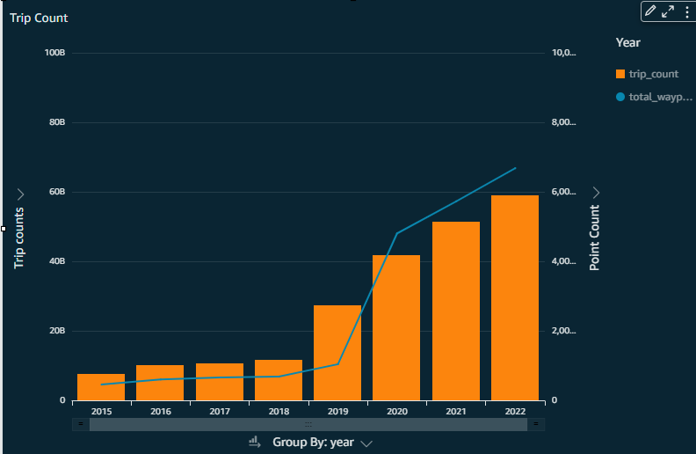
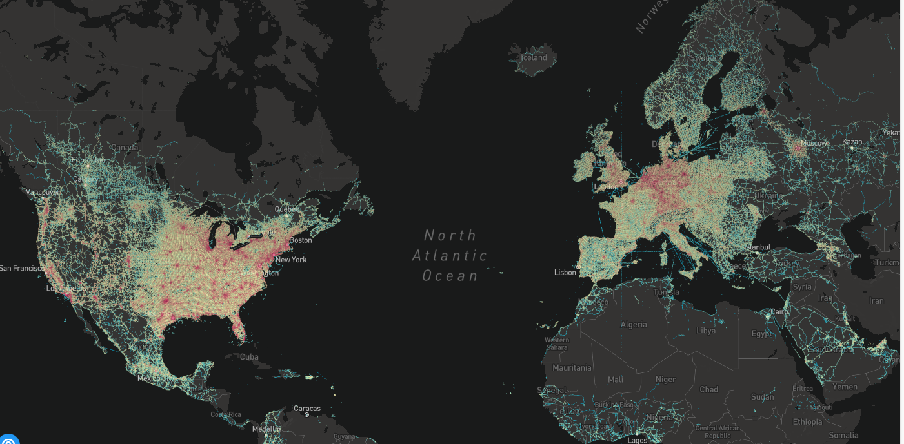
Explosion of Geospatial Data
Driven by connected car and mobile devices enabled for location based services (ride sharing, travel apps, retail, etc)
More than 200 million trips, 20 billion GPS points globally daily
Requires a big data technology stack to process!

Slide 9
System Architecture

Slide 10
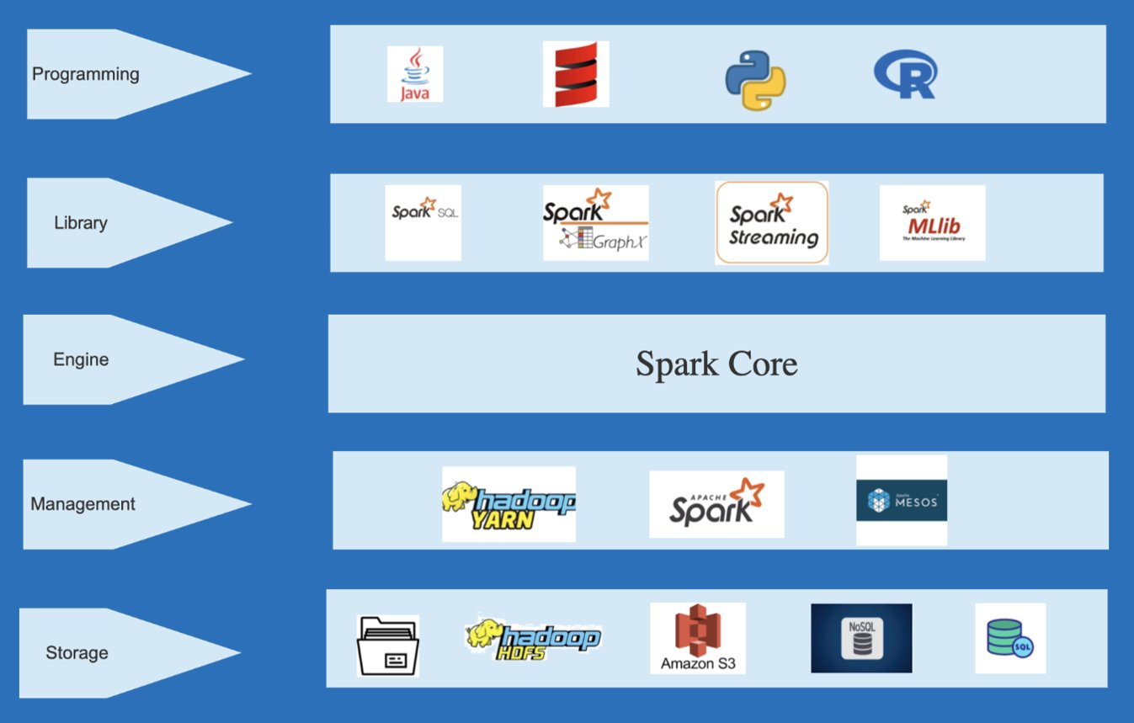




Distributed Data Processing with Spark on AWS EMR
Workload split across multiple workers
Distributed storage using Hadoop/HDFS
Fault tolerant
Many language bindings
SparkSQL and dataframe APIs for manipulating data
High performance due to in-memory computation
Data caching and reuse
No out of box geospatial support
Hosted in the AWS cloud
SDKs and scripts for job submission
Transient cluster: cluster terminates when job is done
Cost effective using cheaper AWS pricing strategies such as spot

Slide 11

Spark with JTS
Spark for parallel processing
JTS wrapper for spatial operations
Local spatial indexes with broadcasting to all workers
load
normalize
spatial index
broadcast
spatial join
algorithms
store

Slide 12
Performance Bottlenecks with JTS
Technology limitations when joining large geospatial datasets at scale
JTS implementation collected spatial data onto a single node and broadcasting to workers
Lots of boilerplate code
On very large datasets, index creation was very slow
Large broadcast requires large memory footprint
// build spatial indexes val zoneSpatialIndexBuilder: ZoneSpatialIndexBuilder = new ZoneSpatialIndexBuilder(sqlContext) val (zoneSpatialIndexes, envs) = zoneSpatialIndexBuilder.buildSpatialIndexes(zoneDF, 0)
// broadcast zone spatial indexes to all workers val bcZoneSpatialIndexes = sc.broadcast(zoneSpatialIndexes)
// query index
final Point point = GeometryFactoryWrapper.getInstance().createPoint(coordinate); envelop.init(point.getX() - EPS, point.getX() + EPS, point.getY() - EPS, point.getY() + EPS); final List list = spatialIndexes.query(envelop);
// extract features
for (final Object obj : list) { final PreparedFeature preparedFeature = (PreparedFeature) obj; if (preparedFeature.getPreparedGeometry().intersects(point)) { retList.add(preparedFeature); } }

Slide 13

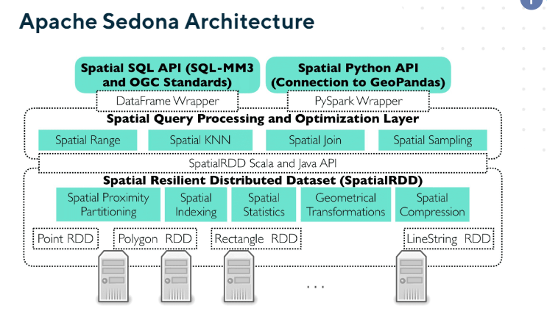
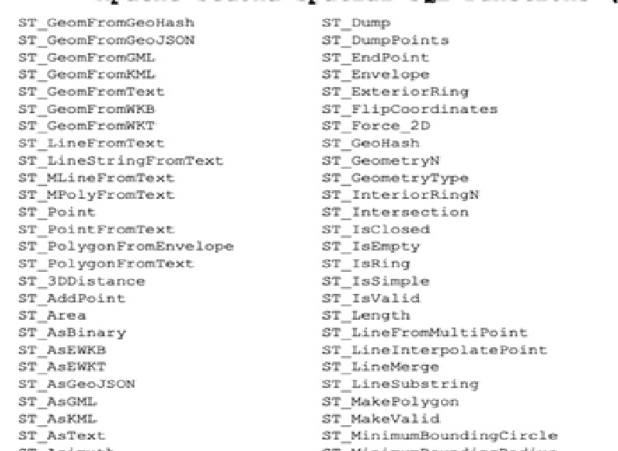
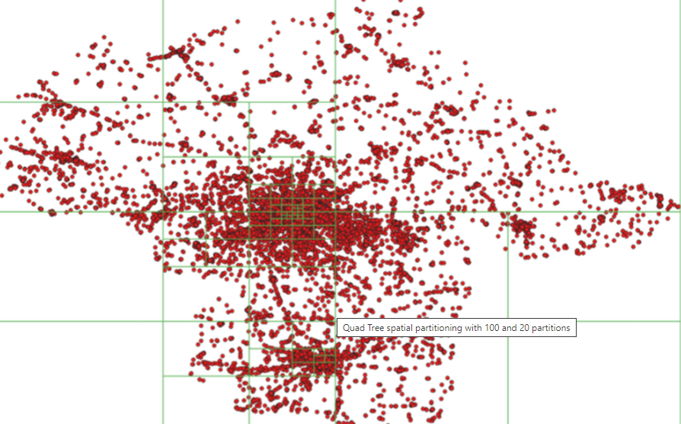
Examples of Sedona Spatial Queries
Extends Spark SQL, dataframes and RDD apis with support for geometry datatypes and spatial operations
Spatial data partitioning and efficient binary serialization across distributed workers (spatial data inherently skewed)
On-the-fly spatial indexing (Rtree and Quadtree)
Rich set of geospatial functions
SELECT trip_id, mode, trip_distance_m,
start_lat, start_lon, start_time, end_time,
poi_placekey from t join poi
where st_intersects(geom, ST_Point(start_lon, start_lat))

Slide 14
Benchmark with Apache Sedona
Very good performance compared to traditional Spark on JTS
With proper performance tuning: spatially join 80 million GPS points with 4 million polygons in less than 15 minutes
Easy to integrate Sedona with Spark
Comprehensive set of spatial functions
Good support from forum
More info at: https://sedona.apache.org/

Slide 15
INRIX Analytics
Discussion
Visit: iq.inrix.com
Contact: Devon Simpson devon.simpson@inrix.com
Trang Nguyen trang.nguyen@inrix.com
15

